Slide 1



Airport Authority Data Analysis
View in Power BI
Last data refresh:
9/2/2024 6:07:19 PM UTC
Downloaded at:
9/3/2024 6:05:26 PM UTC

Slide 2
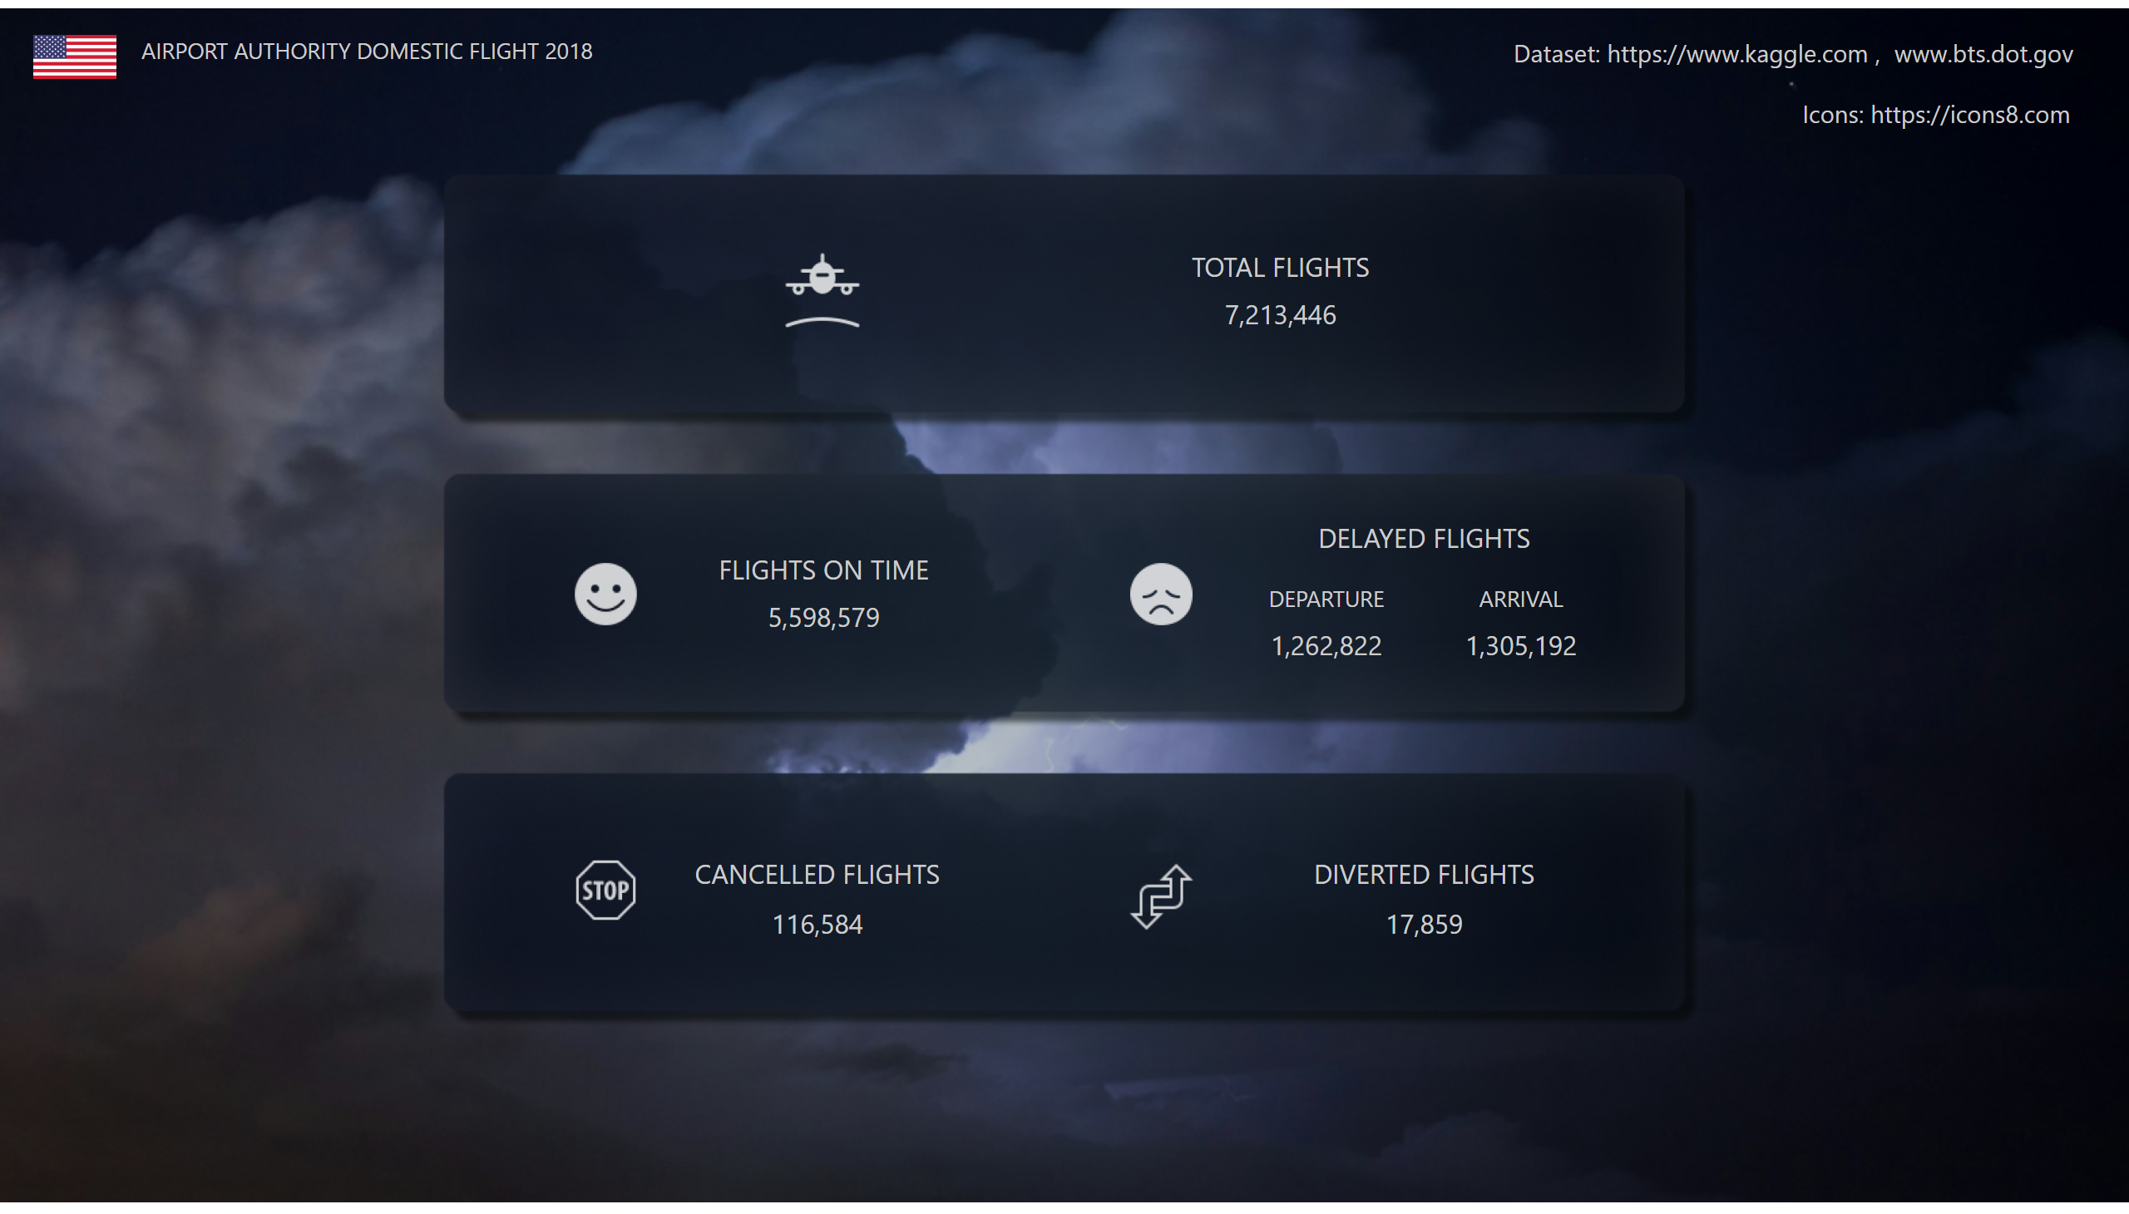
Home Page
Notes:
FLIGHTS ON TIME
No alt text provided
DELAYED FLIGHTS
No alt text provided
TOTAL FLIGHTS
No alt text provided
CANCELLED FLIGHTS
No alt text provided
DIVERTED FLIGHTS
No alt text provided
USA Flag
No alt text provided
textbox
No alt text provided
actionButton
No alt text provided
actionButton
No alt text provided
actionButton
No alt text provided
image
No alt text provided
image
No alt text provided
image
No alt text provided
image
No alt text provided
image
No alt text provided
actionButton
No alt text provided
actionButton
No alt text provided
actionButton
No alt text provided

Slide 3
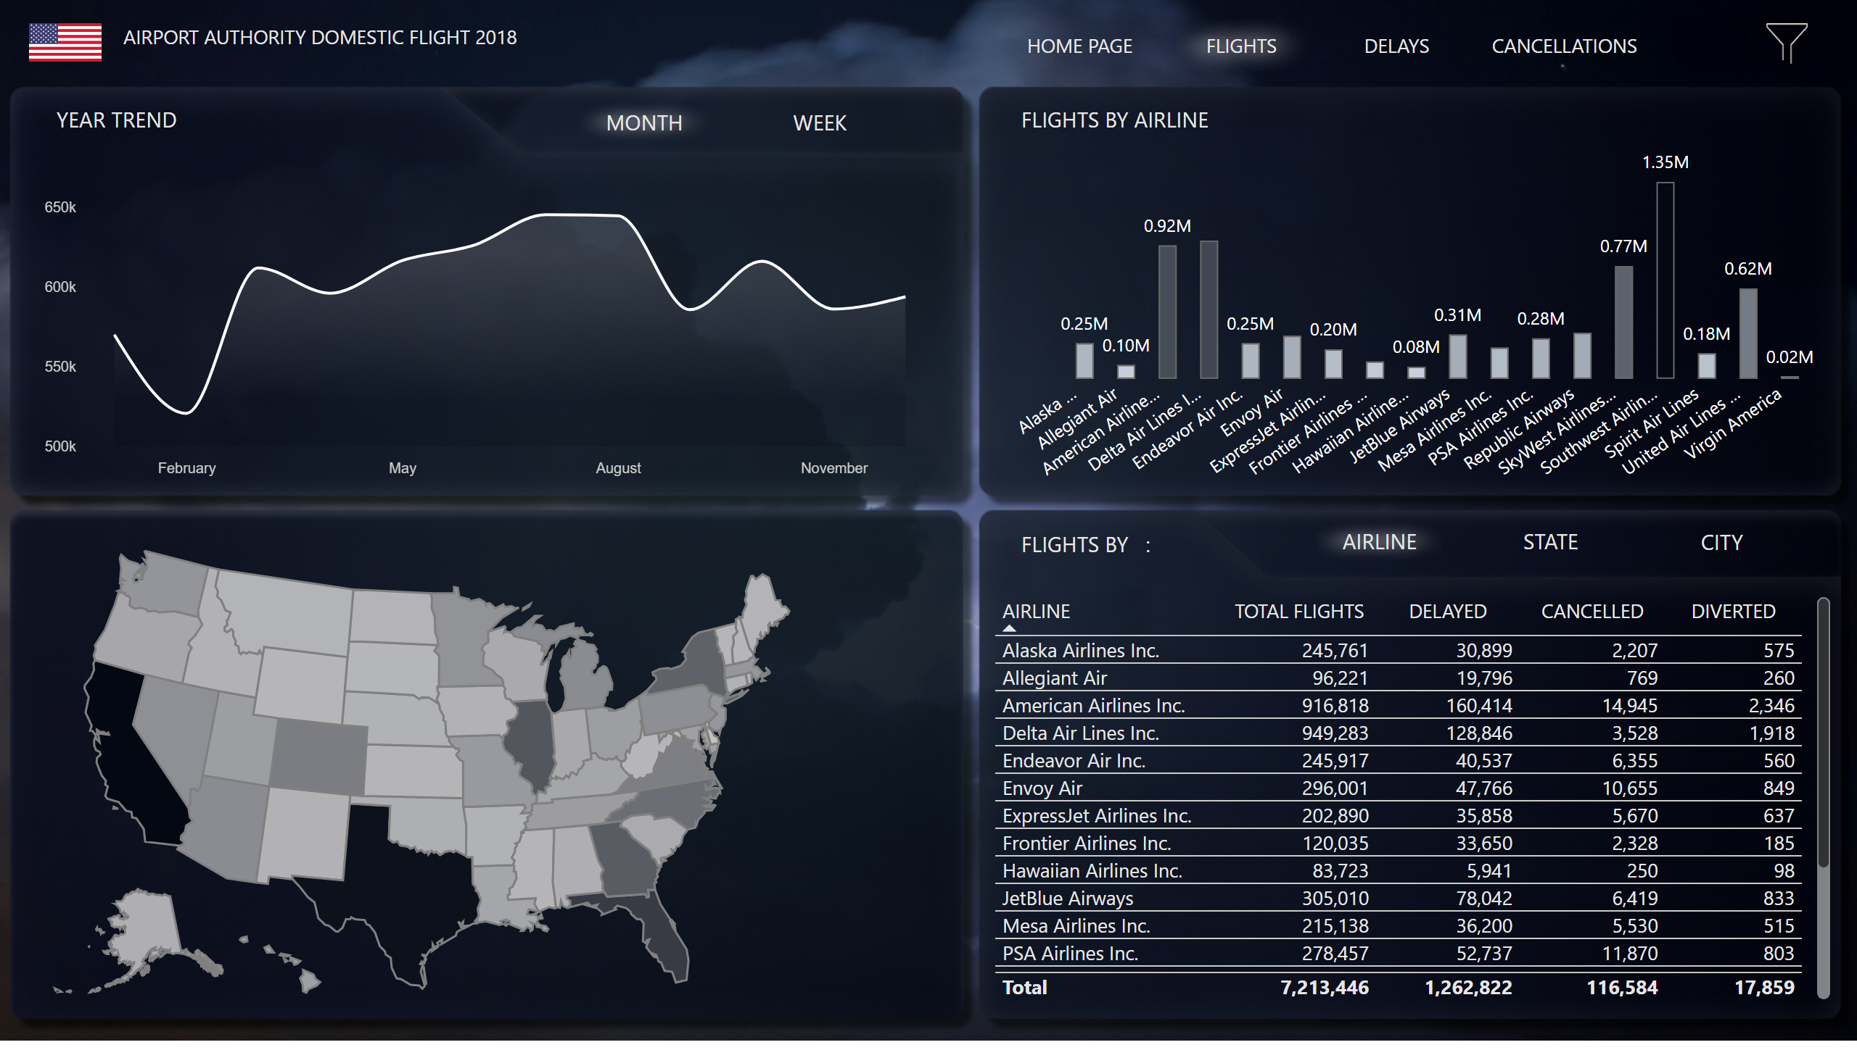
Flights
Notes:
STATE SELECTION
No alt text provided
Count Sls Slicers But
No alt text provided
actionButton
No alt text provided
actionButton
No alt text provided
deneb7E15AEF80B9E4D4F8E12924291ECE89A
No alt text provided
Deneb Flights Month
No alt text provided
Month Button Active
No alt text provided
Week Button Inact
No alt text provided
Button Flights
No alt text provided
Airlines Table
No alt text provided
Button City 1
No alt text provided
Airline Button Active
No alt text provided
Button State 22
No alt text provided
tableEx
No alt text provided
actionButton
No alt text provided
actionButton
No alt text provided
actionButton
No alt text provided
tableEx
No alt text provided
actionButton
No alt text provided
actionButton
No alt text provided
actionButton
No alt text provided
Slicers Button
No alt text provided
Page Header
No alt text provided
Button Home Page
No alt text provided
slicer
No alt text provided
slicer
No alt text provided
slicer
No alt text provided
slicer
No alt text provided
actionButton
No alt text provided
slicer
No alt text provided
actionButton
No alt text provided
image
No alt text provided
Tables Header
No alt text provided
Bar Airlines Header
No alt text provided
Bar Flights by Airline
No alt text provided
USA Map
No alt text provided
Ttl Flights Header
No alt text provided
Button Cancellations
No alt text provided
Button Delays
No alt text provided
USA Flag
No alt text provided

Slide 4
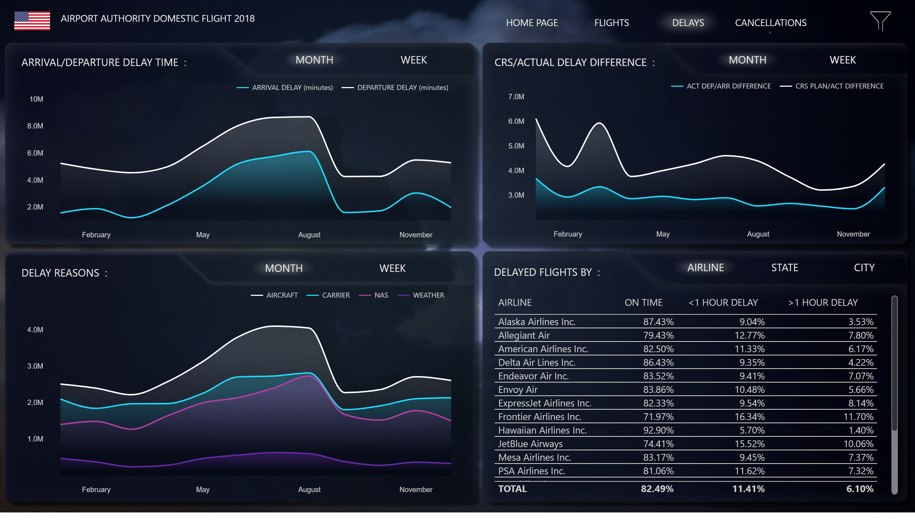
Delays
Notes:
textbox
No alt text provided
USA Flag
No alt text provided
Page Header
No alt text provided
Button Home Page
No alt text provided
Button Flights
No alt text provided
Button Delays
No alt text provided
Button Cancellations
No alt text provided
Slicers Button
No alt text provided
tableEx
No alt text provided
actionButton
No alt text provided
actionButton
No alt text provided
actionButton
No alt text provided
actionButton
No alt text provided
actionButton
No alt text provided
actionButton
No alt text provided
tableEx
No alt text provided
Airline Button Act1
No alt text provided
Button State Inact2
No alt text provided
Button City Inact2
No alt text provided
Table Airline
No alt text provided
textbox
No alt text provided
textbox
No alt text provided
Den Del Reasons Month
No alt text provided
Month DRButton Active
No alt text provided
Week DRButton Inact
No alt text provided
Month ArDButton Active
No alt text provided
Week ArDButton Inact
No alt text provided
Den Ar/Dep Time Month
No alt text provided
actionButton
No alt text provided
actionButton
No alt text provided
deneb7E15AEF80B9E4D4F8E12924291ECE89A
No alt text provided
actionButton
No alt text provided
actionButton
No alt text provided
deneb7E15AEF80B9E4D4F8E12924291ECE89A
No alt text provided
Den CRS Month
No alt text provided
Month DCRSBut Active
No alt text provided
Week DCRSBut Inact
No alt text provided
deneb7E15AEF80B9E4D4F8E12924291ECE89A
No alt text provided
actionButton
No alt text provided
actionButton
No alt text provided
textbox
No alt text provided
slicer
No alt text provided
slicer
No alt text provided
slicer
No alt text provided
slicer
No alt text provided
actionButton
No alt text provided
actionButton
No alt text provided
image
No alt text provided
slicer
No alt text provided
Count Sls Slicers But
No alt text provided

Slide 5
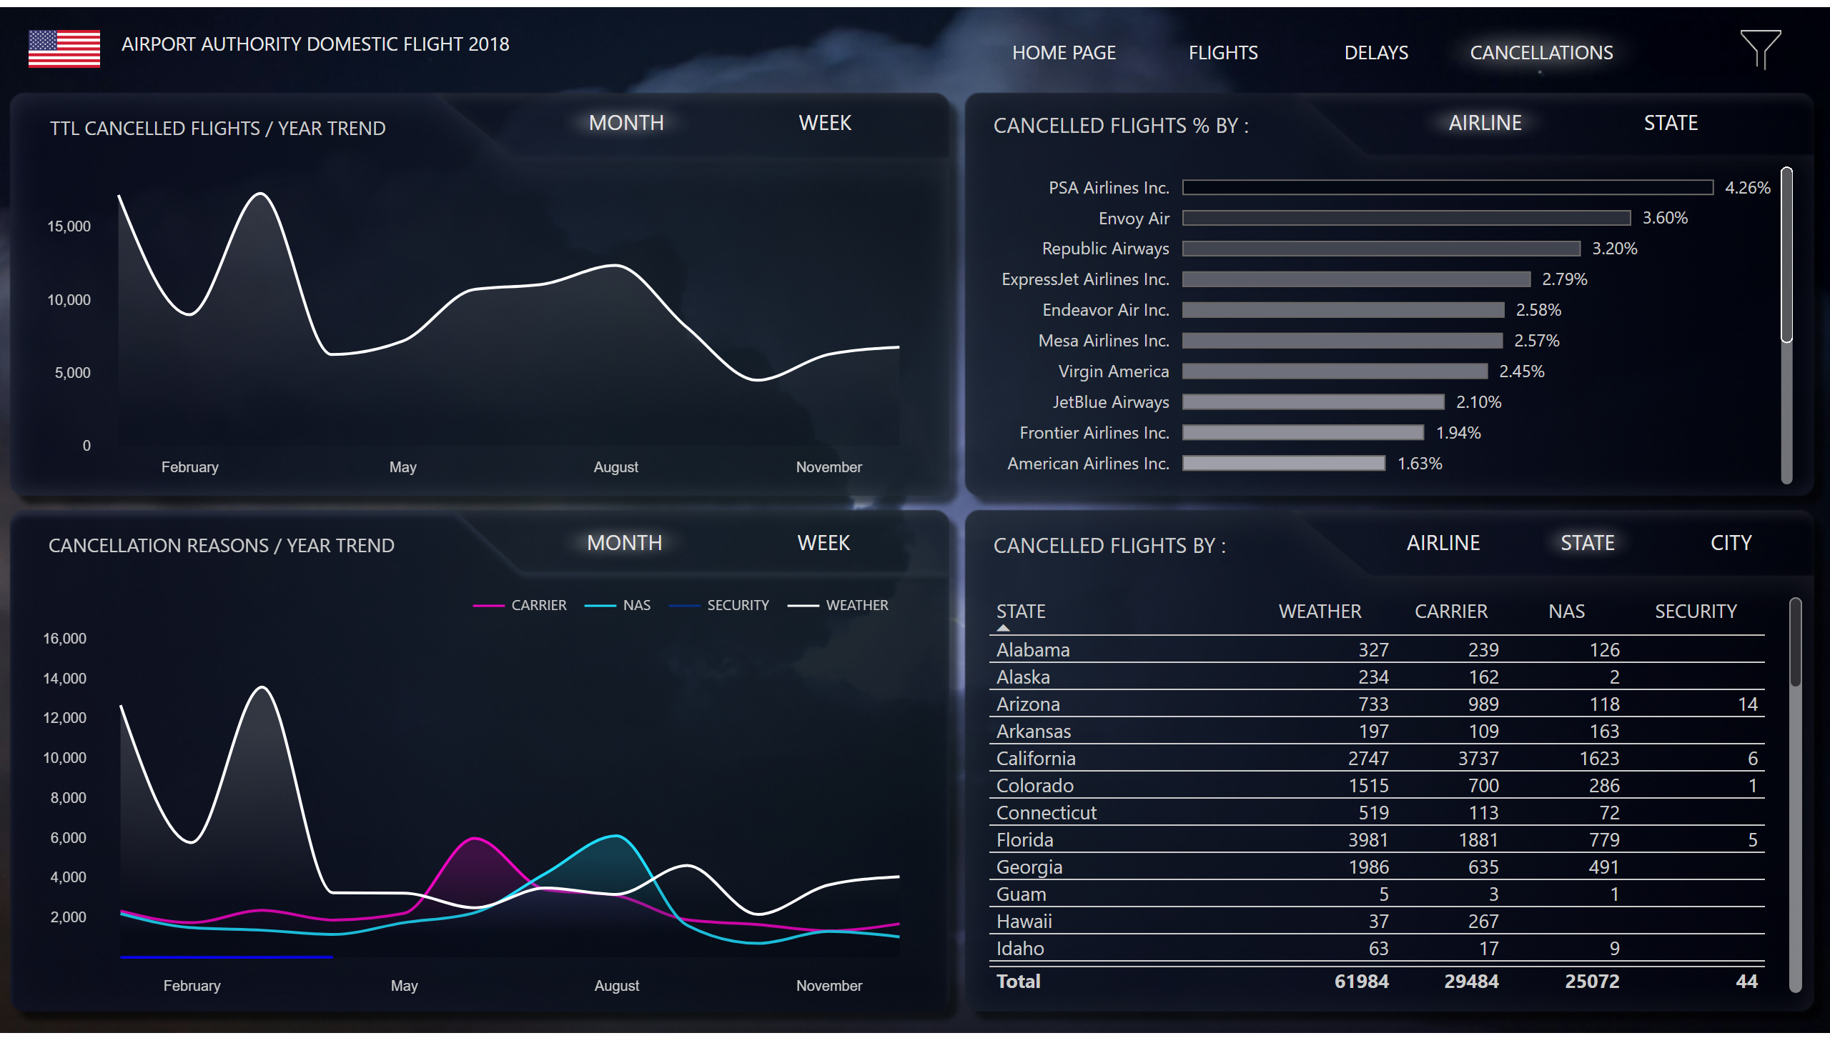
Cancellations
Notes:
textbox
No alt text provided
textbox
No alt text provided
barChart
No alt text provided
actionButton
No alt text provided
actionButton
No alt text provided
USA Flag
No alt text provided
Page Header
No alt text provided
Button Home Page
No alt text provided
Button Flights
No alt text provided
Button Delays
No alt text provided
Button Cancellations
No alt text provided
Slicers Button
No alt text provided
Table C Header
No alt text provided
barChart
No alt text provided
Airline Button 1
No alt text provided
Button State 1
No alt text provided
Week СButton Inact
No alt text provided
Month СButton Active
No alt text provided
Deneb C Month Trend
No alt text provided
actionButton
No alt text provided
actionButton
No alt text provided
deneb7E15AEF80B9E4D4F8E12924291ECE89A
No alt text provided
tableEx
No alt text provided
actionButton
No alt text provided
actionButton
No alt text provided
actionButton
No alt text provided
actionButton
No alt text provided
actionButton
No alt text provided
actionButton
No alt text provided
tableEx
No alt text provided
Button City Inact2
No alt text provided
Button State Act2
No alt text provided
Airline Button Act2
No alt text provided
State Table
No alt text provided
Deneb CReas Month
No alt text provided
Month СRButton Active
No alt text provided
Week СRButton Inact
No alt text provided
actionButton
No alt text provided
actionButton
No alt text provided
deneb7E15AEF80B9E4D4F8E12924291ECE89A
No alt text provided
textbox
No alt text provided
slicer
No alt text provided
slicer
No alt text provided
slicer
No alt text provided
slicer
No alt text provided
slicer
No alt text provided
actionButton
No alt text provided
actionButton
No alt text provided
image
No alt text provided
Count Sls Slicers But
No alt text provided

